Slide 1
Humility & Hope
2024 Quarter 4 Lesson 10
The Desire of Ages Ch. 71 & 73
John 13 & 14

Slide 2
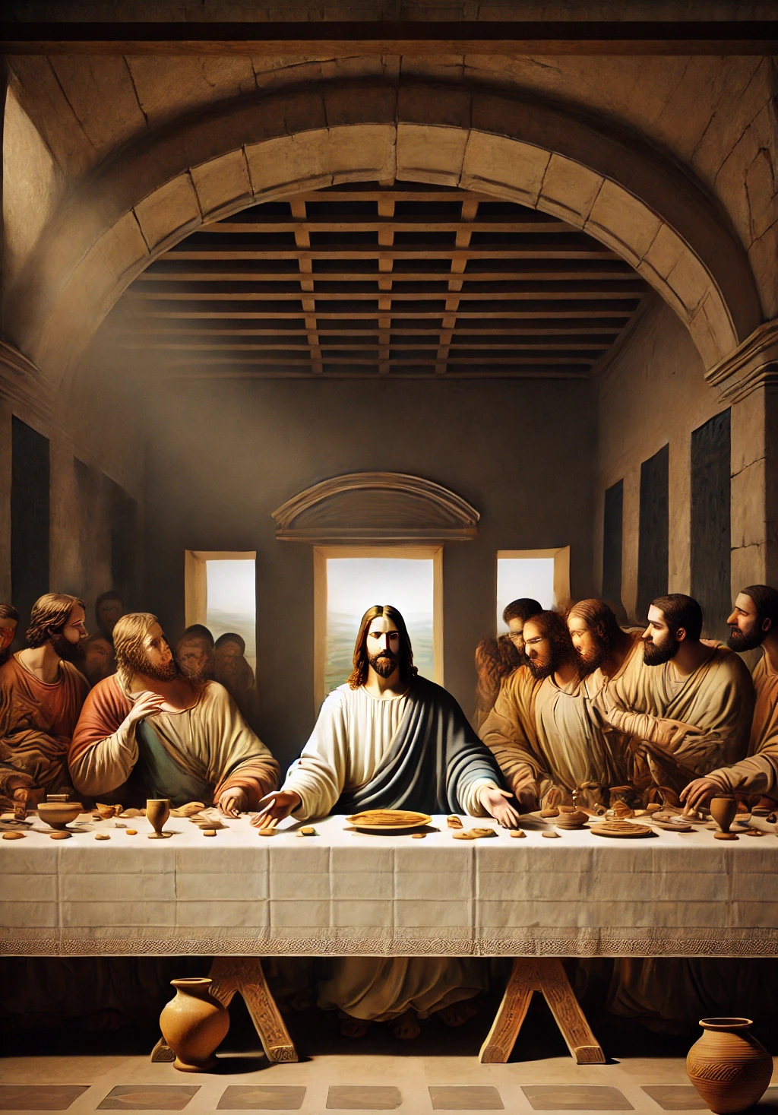
The Ordinance of Humility
On this last evening with His disciples, Jesus had much to tell them. If they had been prepared to receive what He longed to impart, they would have been saved from heartbreaking anguish, from disappointment and unbelief. But Jesus saw that they could not bear what He had to say.
The Desire of Ages p. 643

Slide 3
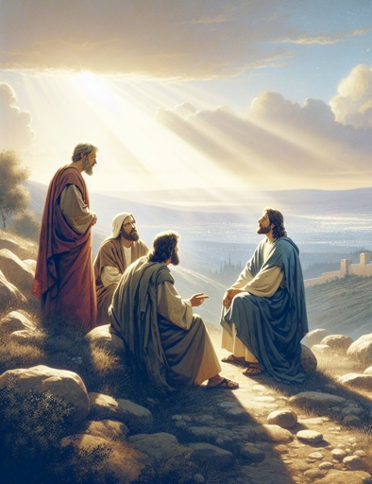
The Ordinance of Humility
There was “a strife among them, which of them should be accounted the greatest.” This contention, carried on in the presence of Christ, grieved and wounded Him. The disciples clung to their favorite idea that Christ would assert His power, and take His position on the throne of David. And in heart each still longed for the highest place in the kingdom.
The Desire of Ages p. 643

Slide 4

The Ordinance of Humility
They had placed their own estimate upon themselves and upon one another, and, instead of regarding their brethren as more worthy, they had placed themselves first. The request of James and John to sit on the right and left of Christ's throne had excited the indignation of the others.
The Desire of Ages p. 643

Slide 5
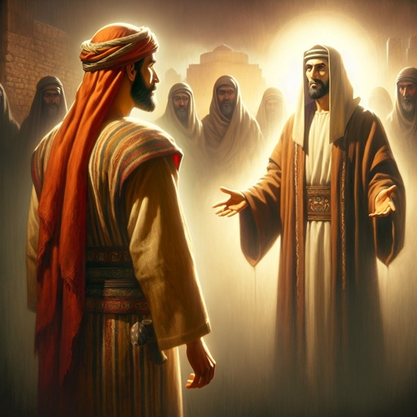
The Ordinance of Humility
When the disciples entered the supper room, their hearts were full of resentful feelings. Judas pressed next to Christ on the left side; John was on the right. If there was a highest place, Judas was determined to have it, and that place was thought to be next to Christ. And Judas was a traitor.
The Desire of Ages p. 644

Slide 6

The Ordinance of Humility
Another cause of dissension had arisen. At a feast it was customary for a servant to wash the feet of the guests, and on this occasion preparation had been made for the service. The pitcher, the basin, and the towel were there, in readiness for the feet washing; but no servant was present, and it was the disciples’ part to perform it.
The Desire of Ages p. 644

Slide 7
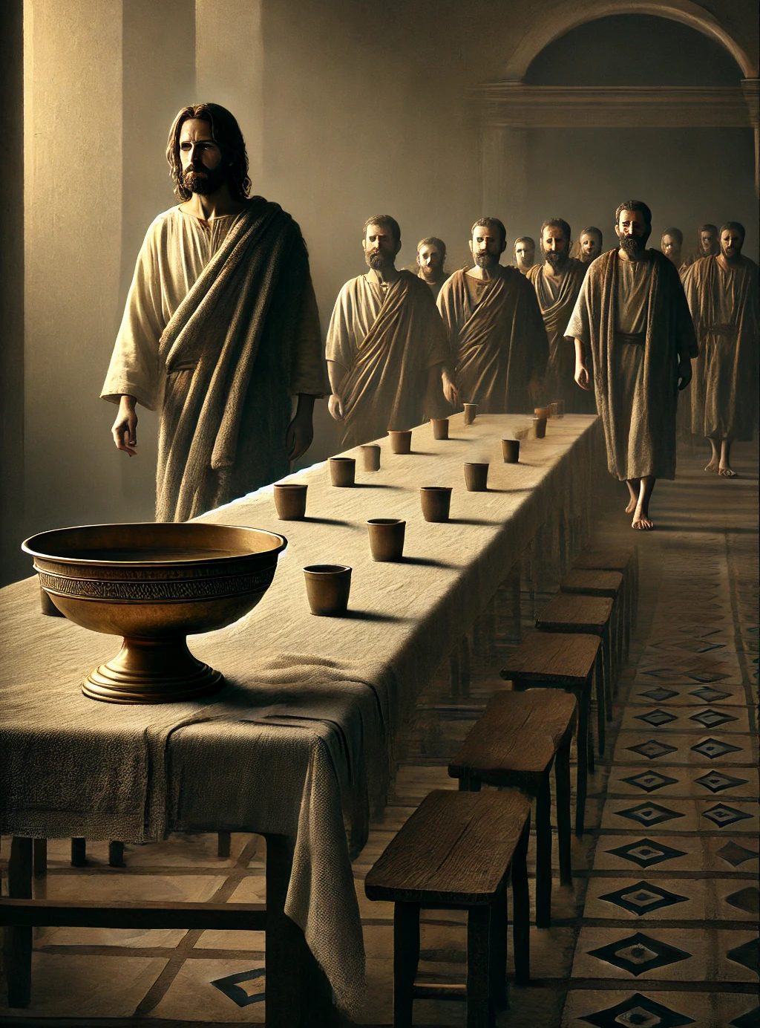
The Ordinance of Humility
But each of the disciples, yielding to wounded pride, determined not to act the part of a servant. All manifested a stoical unconcern, seeming unconscious that there was anything for them to do. By their silence they refused to humble themselves.
The Desire of Ages p. 644

Slide 8
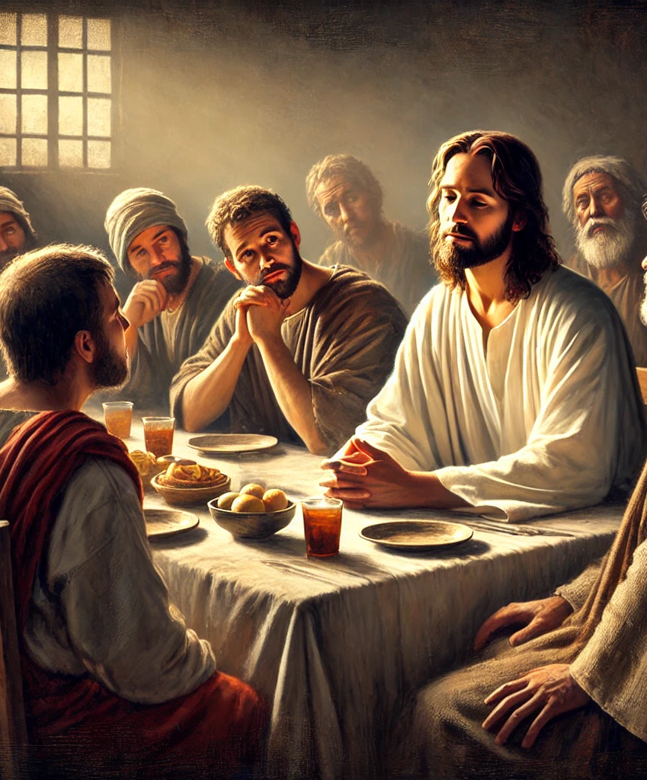
The Ordinance of Humility
How was Christ to bring these poor souls where Satan would not gain over them a decided victory? How could He show that a mere profession of discipleship did not make them disciples, or insure them a place in His kingdom? How could He show that it is loving service, true humility, which constitutes real greatness? How was He to kindle love in their hearts, and enable them to comprehend what He longed to tell them?
The Desire of Ages p. 644

Slide 9
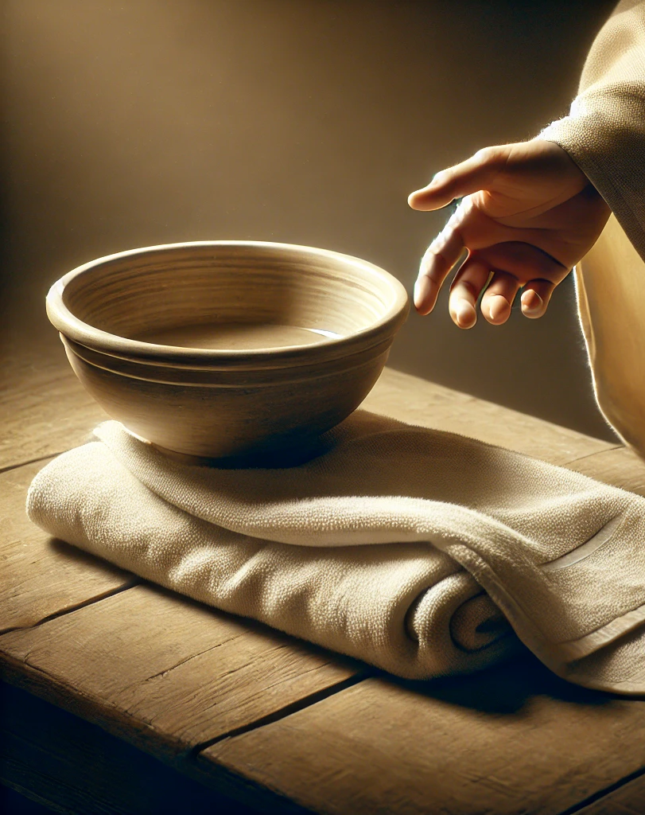
The Ordinance of Humility
The disciples made no move toward serving one another. Jesus waited for a time to see what they would do. Then He, the divine Teacher, rose from the table. Laying aside the outer garment that would have impeded His movements, He took a towel, and girded Himself. With surprised interest the disciples looked on, and in silence waited to see what was to follow.
The Desire of Ages p. 644

Slide 10
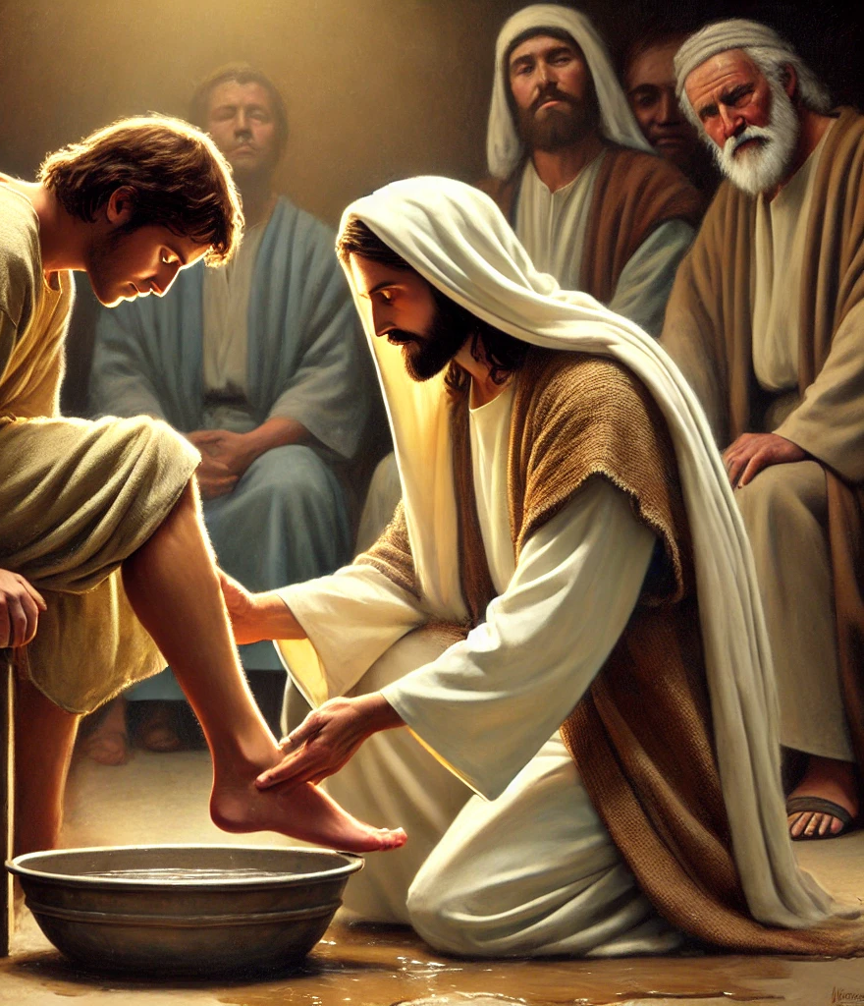
The Ordinance of Humility
“After that He poureth water into a basin, and began to wash the disciples’ feet, and to wipe them with the towel wherewith He was girded.” This action opened the eyes of the disciples. Bitter shame and humiliation filled their hearts. They understood the unspoken rebuke, and saw themselves in altogether a new light.
The Desire of Ages p. 644

Slide 11
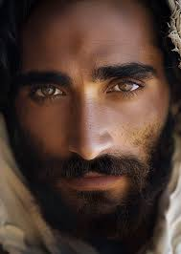
The Ordinance of Humility
So Christ expressed His love for His disciples. Their selfish spirit filled Him with sorrow, but He entered into no controversy with them regarding their difficulty. Instead He gave them an example they would never forget.
The Desire of Ages p. 644

Slide 12
The Ordinance of Humility
So Christ expressed His love for His disciples. Their selfish spirit filled Him with sorrow, but He entered into no controversy with them regarding their difficulty. Instead He gave them an example they would never forget.
The Desire of Ages p. 644

Slide 13
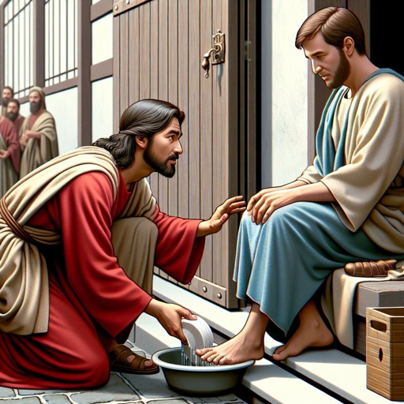
Peter's Objection (John 13:6)
Then cometh he to Simon Peter: and Peter saith unto him, Lord, dost thou wash my feet?
Peter could not bear to see his Lord, whom he believed to be the Son of God, acting the part of a servant. His whole soul rose up against this humiliation. DA p. 645

Slide 14
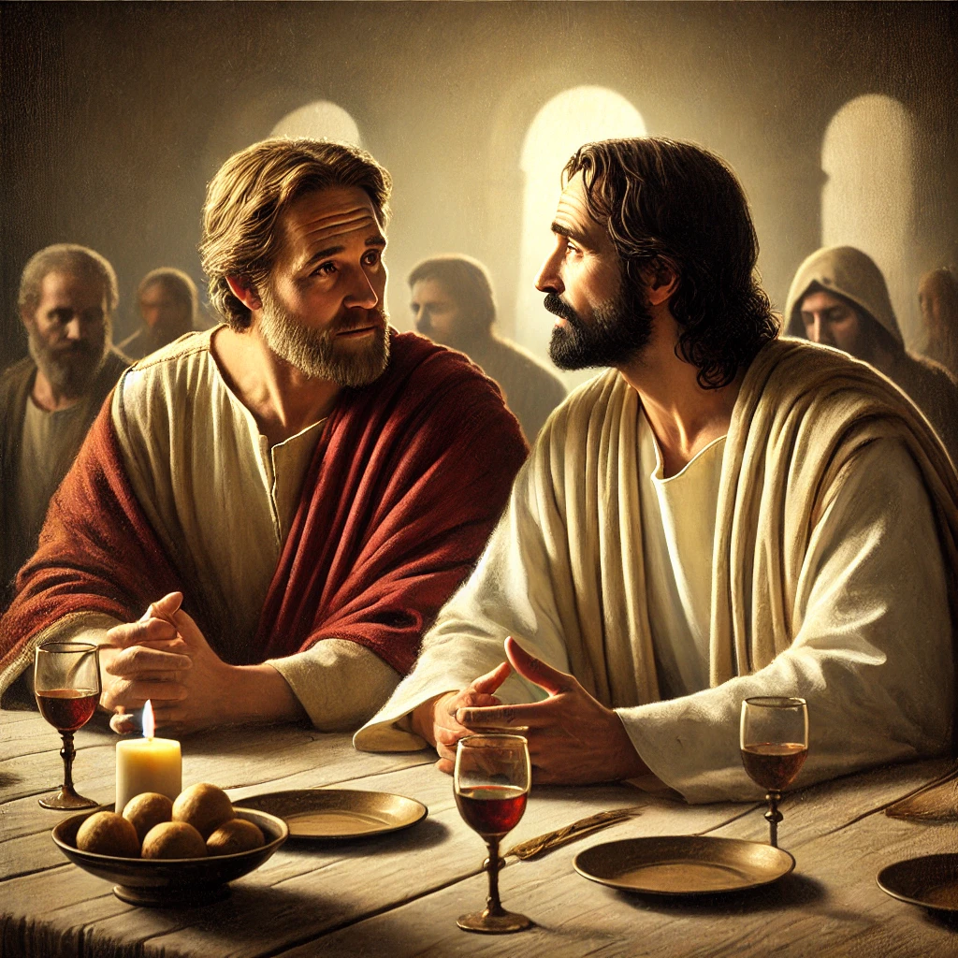
Peter's Objection (John 13:7)
Jesus answered and said unto him, What I do thou knowest not now; but thou shalt know hereafter.

Slide 15
Peter's Objection (John 13:8)
Peter saith unto him, Thou shalt never wash my feet. Jesus answered him, If I wash thee not, thou hast no part with me.
At these words, Peter surrendered his pride and self-will. He could not endure the thought of separation from Christ; that would have been death to him. DA p. 646

Slide 16
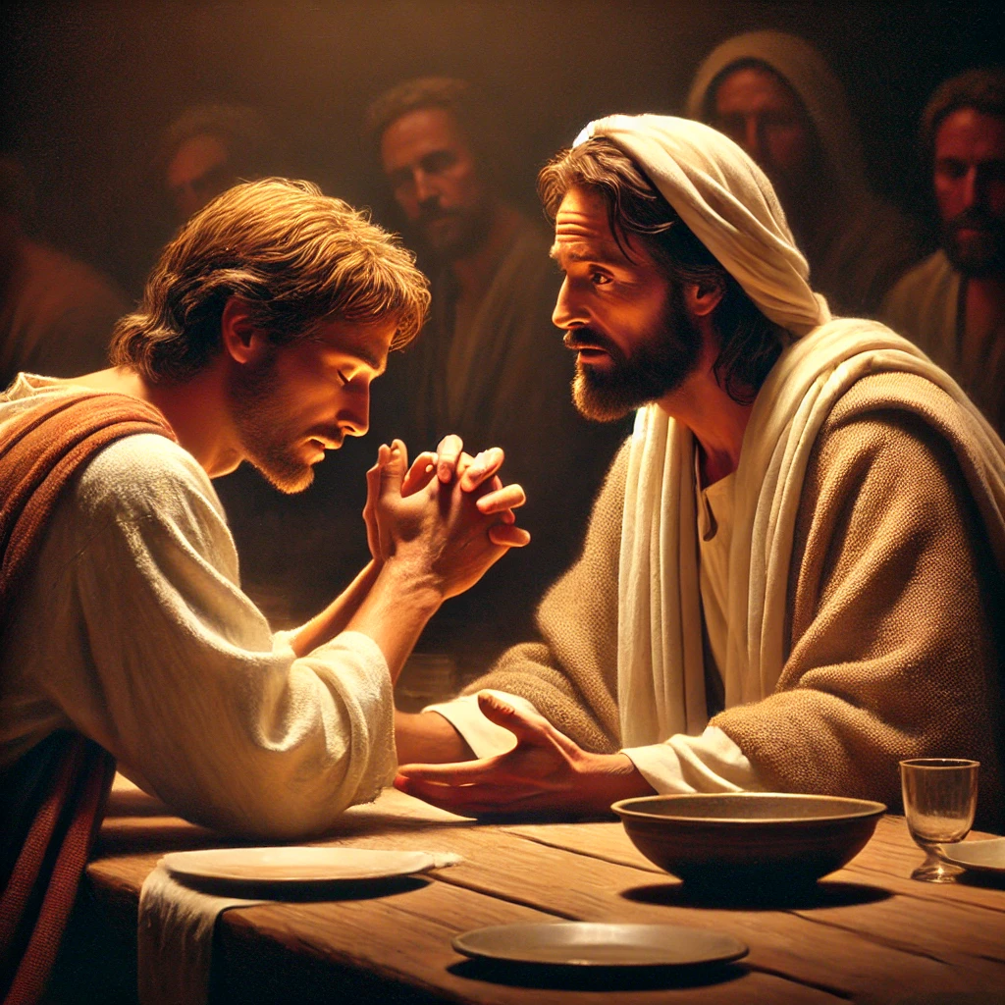
Peter's Objection (John 13:9)
Simon Peter saith unto him, Lord, not my feet only, but also my hands and my head.

Slide 17
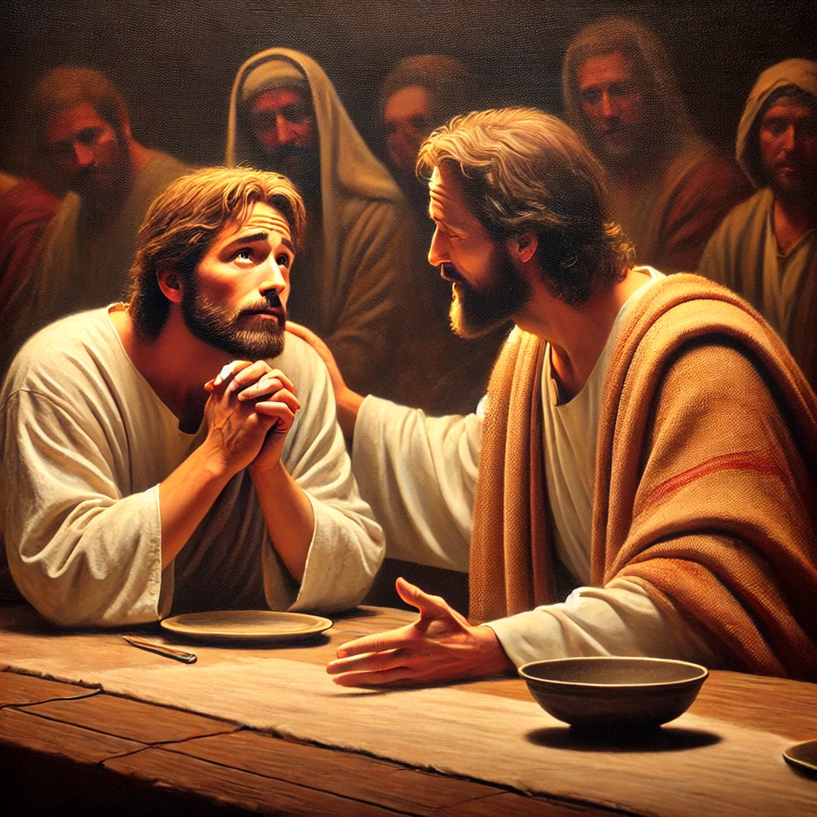
Peter's Objection (John 13:10)
Jesus saith to him, He that is washed needeth not save to wash his feet, but is clean every whit: and ye are clean, but not all.
Pride and self-seeking create dissension and hatred, but all this Jesus washed away in washing their feet. A change of feeling was brought about. DA p. 646

Slide 18
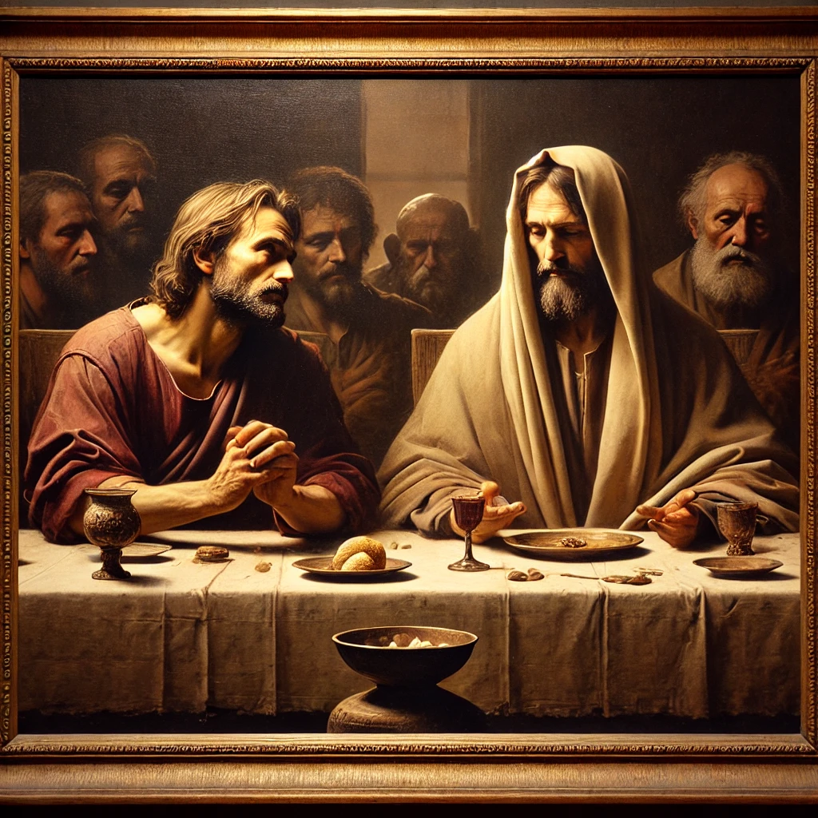
Peter's Objection (John 13:11)
For he knew who should betray him; therefore said he, Ye are not all clean.

Slide 19
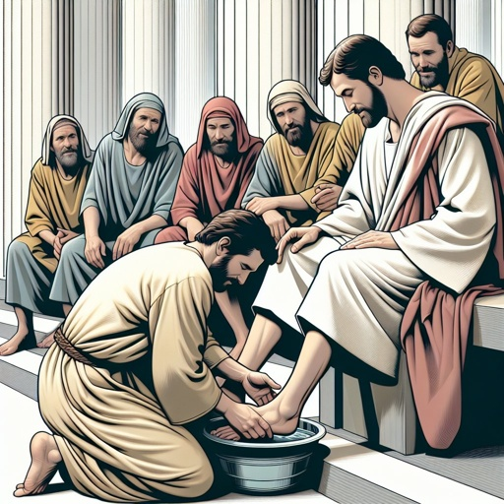
Humility (John 13:12)
So after he had washed their feet, and had taken his garments, and was set down again, he said unto them, Know ye what I have done to you?

Slide 20
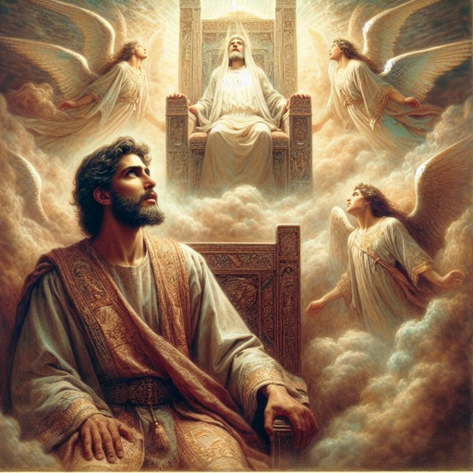
Humility (John 13:13)
Ye call me Master and Lord: and ye say well; for so I am.

Slide 21
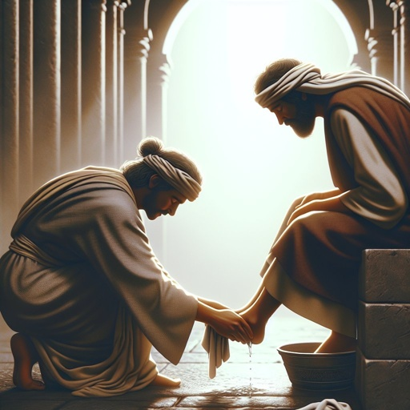
Humility (John 13:14)
If I then, your Lord and Master, have washed your feet; ye also ought to wash one another's feet.

Slide 22
That His people might not be misled by the selfishness which dwells in the natural heart, and which strengthens by self-serving, Christ Himself set the example of humility. He would not leave this great subject in man's charge.
The Desire of Ages p. 649

Slide 23
Of so much consequence did He regard it, that He Himself, One equal with God, acted as servant to His disciples. While they were contending for the highest place, He to whom every knee shall bow, He whom the angels of glory count it honor to serve, bowed down to wash the feet of those who called Him Lord. He washed the feet of His betrayer.
The Desire of Ages p. 649

Slide 24
In His life and lessons, Christ has given a perfect exemplification of the unselfish ministry which has its origin in God. God does not live for Himself. By creating the world, and by upholding all things, He is constantly ministering for others. “He maketh His sun to rise on the evil and on the good, and sendeth rain on the just and on the unjust.” Matthew 5:45.
The Desire of Ages p. 649

Slide 25
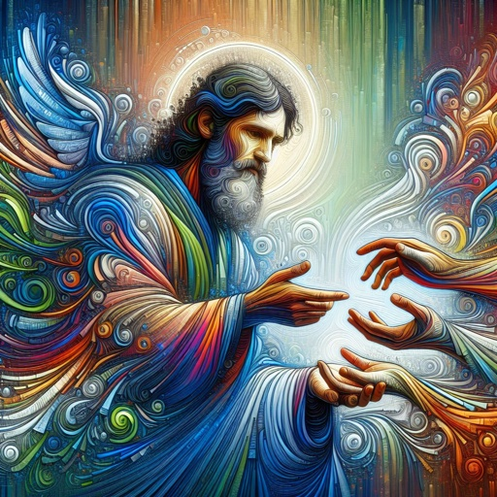
Humility (John 13:15)
For I have given you an example, that ye should do as I have done to you.

Slide 26
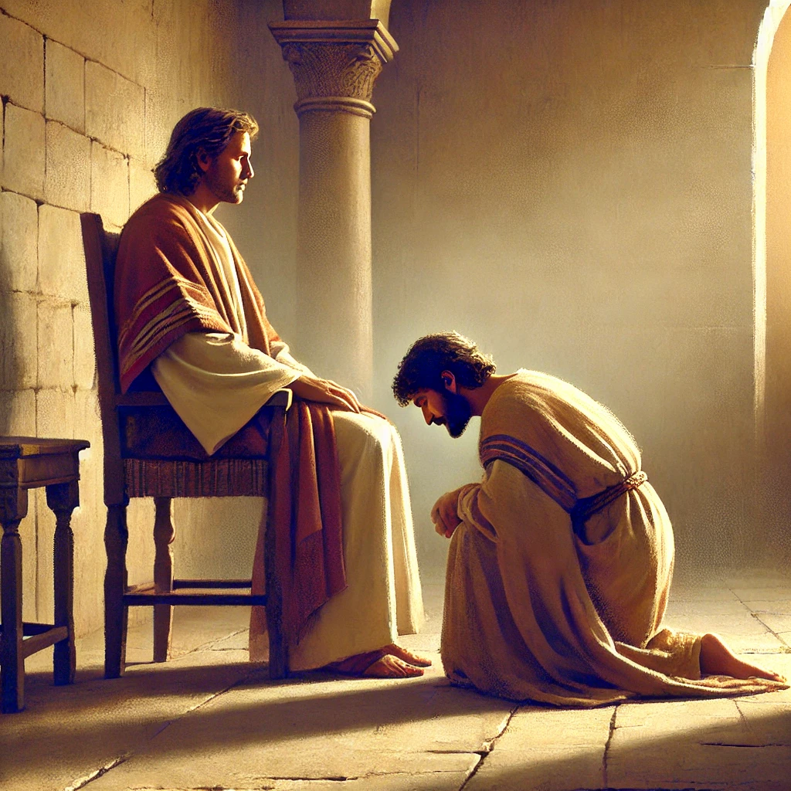
Humility (John 13:16)
Verily, verily, I say unto you, The servant is not greater than his lord; neither he that is sent greater than he that sent him.

Slide 27

Humility (John 13:17)
If ye know these things, happy are ye if ye do them.

Slide 28
In washing the feet of His disciples, Christ gave evidence that He would do any service, however humble, that would make them heirs with Him of the eternal wealth of heaven's treasure. His disciples, in performing the same rite, pledge themselves in like manner to serve their brethren.
The Desire of Ages p. 651

Slide 29
Whenever this ordinance is rightly celebrated, the children of God are brought into a holy relationship, to help and bless each other. They covenant that the life shall be given to unselfish ministry. And this, not only for one another. Their field of labor is as wide as their Master's was.
The Desire of Ages p. 651

Slide 30
The world is full of those who need our ministry. The poor, the helpless, the ignorant, are on every hand. Those who have communed with Christ in the upper chamber will go forth to minister as He did.
The Desire of Ages p. 651

Slide 31
As the lesson of the preparatory service is thus learned, the desire is kindled for a higher spiritual life. To this desire the divine Witness will respond. The soul will be uplifted. We can partake of the Communion with a consciousness of sins forgiven.
The Desire of Ages p. 651

Slide 32
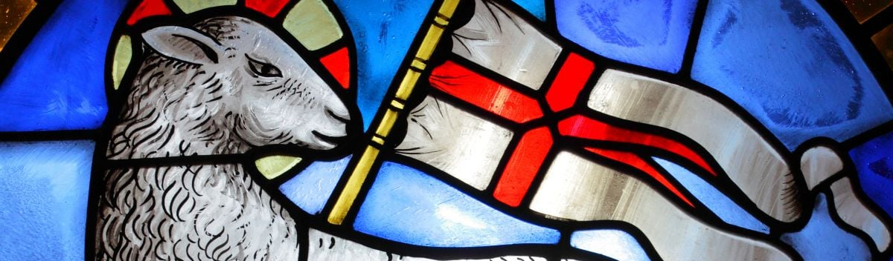
The sunshine of Christ's righteousness will fill the chambers of the mind and the soul temple. We “behold the Lamb of God, which taketh away the sin of the world.” John 1:29.
The Desire of Ages p. 651

Slide 33
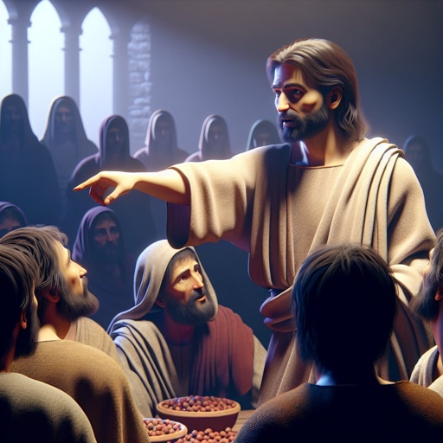
Hope
Then addressing them by the endearing term, “Little children,” He said, “Yet a little while I am with you. Ye shall seek Me: and as I said unto the Jews, Whither I go, ye cannot come; so now I say to you.”
The Desire of Ages p. 662

Slide 34
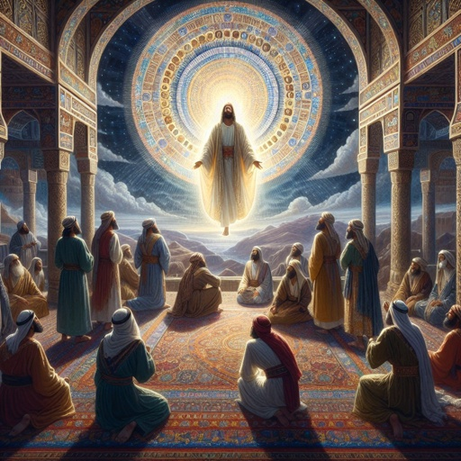
Hope
The disciples could not rejoice when they heard this. Fear fell upon them. They pressed close about the Saviour. Their Master and Lord, their beloved Teacher and Friend, He was dearer to them than life.
The Desire of Ages p. 662

Slide 35
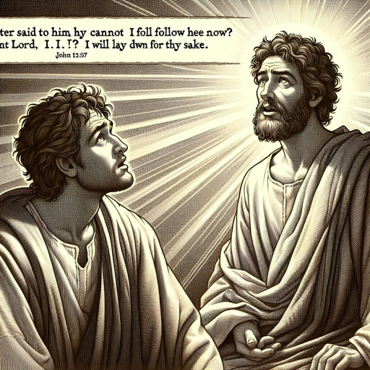
Hope
To Him they had looked for help in all their difficulties, for comfort in their sorrows and disappointments. Now He was to leave them, a lonely, dependent company. Dark were the forebodings that filled their hearts.
The Desire of Ages p. 662

Slide 36
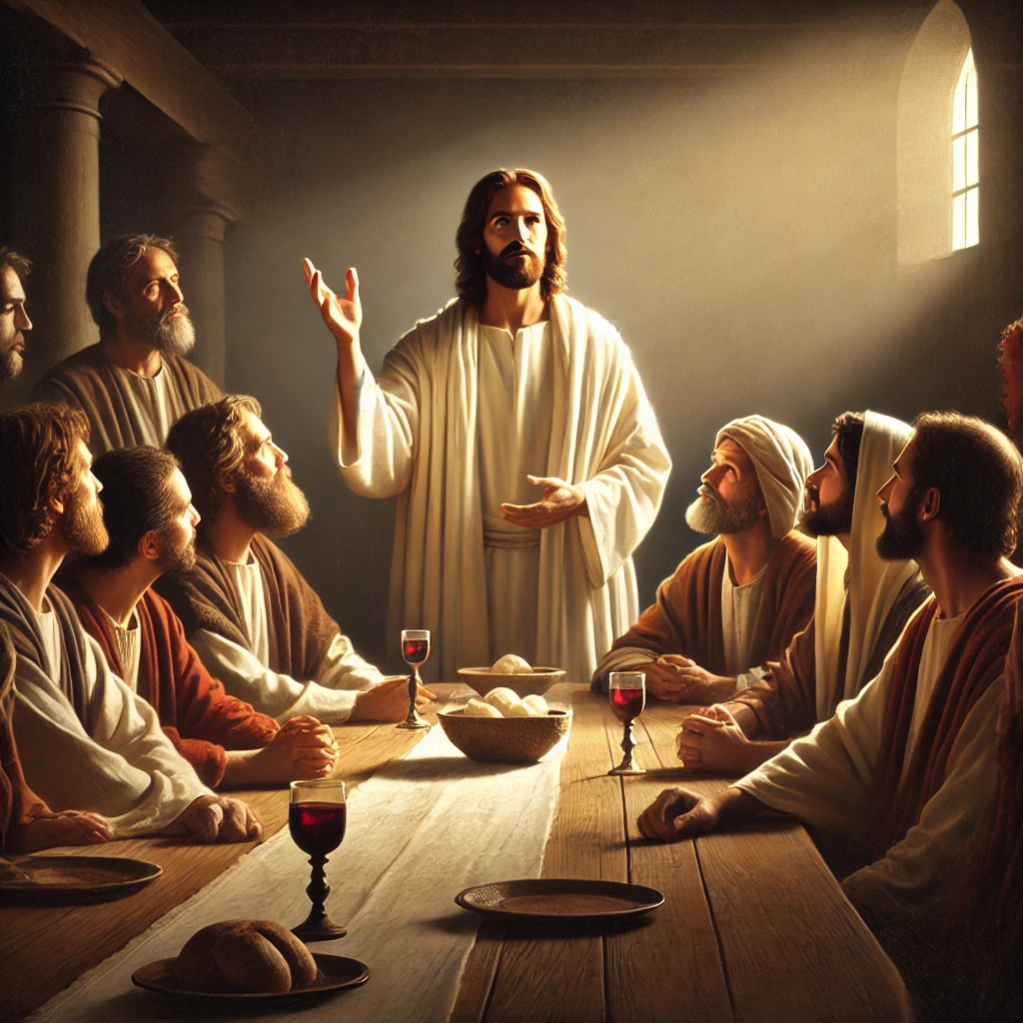
Hope
But the Saviour's words to them were full of hope. He knew that they were to be assailed by the enemy, and that Satan's craft is most successful against those who are depressed by difficulties.
The Desire of Ages p. 662

Slide 37

Hope
Therefore He pointed them away from “the things which are seen,” to “the things which are not seen.” 2 Corinthians 4:18. From earthly exile He turned their thoughts to the heavenly home.
The Desire of Ages p. 662

Slide 38
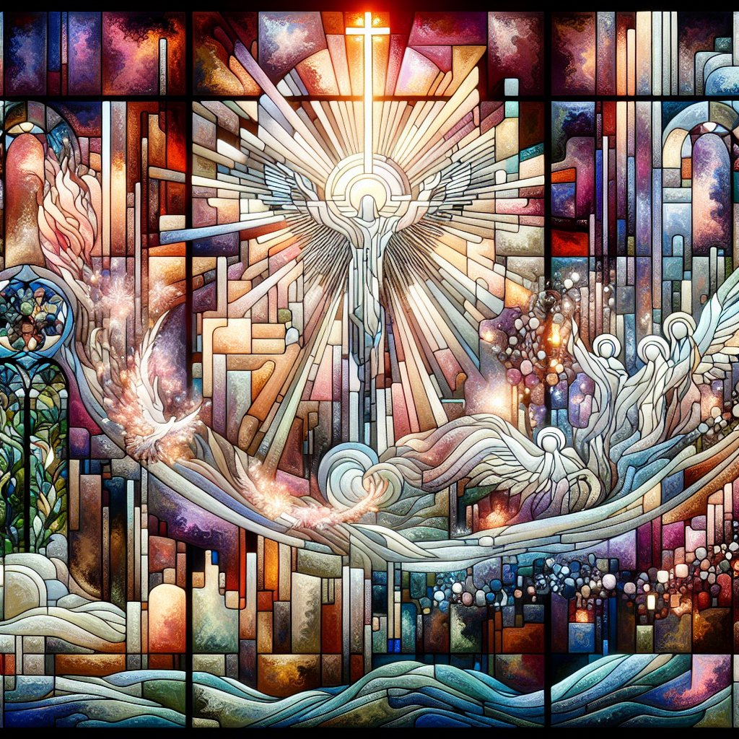
Hope (John 14:1)
Let not your heart be troubled: ye believe in God, believe also in me.

Slide 39
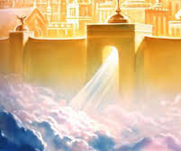
Hope (John 14:2)
In my Father's house are many mansions: if it were not so, I would have told you. I go to prepare a place for you.

Slide 40
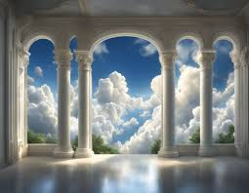
Hope (John 14:3)
And if I go and prepare a place for you, I will come again, and receive you unto myself; that where I am, there ye may be also.

Slide 41
Jesus has gone to His Father’s house. He is waiting with longing desire for the manifestation of Himself in His church. When His image shall be perfectly reproduced in His people, then He will come (COL 69). It is our privilege to hasten the day of glorious home-coming.
SDABC on John 14:3

Slide 42

Hope (John 14:4)
And whither I go ye know, and the way ye know.

Slide 43
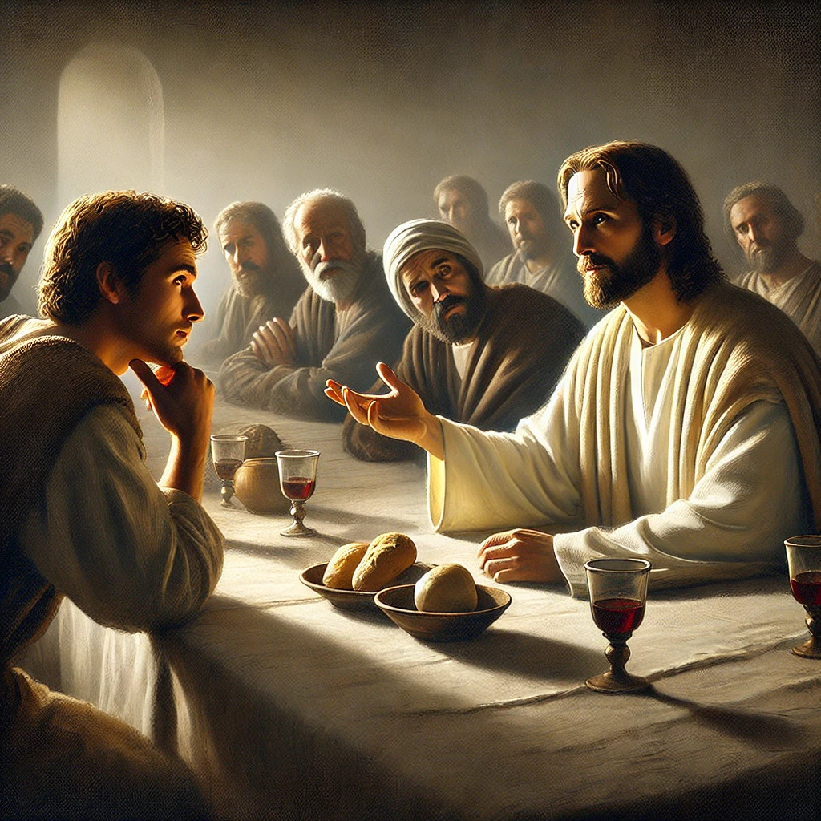
Hope (John 14:5)
Thomas saith unto him, Lord, we know not whither thou goest; and how can we know the way?

Slide 44
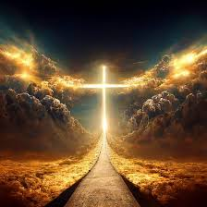
Hope (John 14:6)
Jesus saith unto him, I am the way, the truth, and the life: no man cometh unto the Father, but by me.

Slide 45
There are not many ways to heaven. Each one may not choose his own way. Christ says, “I am the way: ... no man cometh unto the Father, but by Me.” Since the first gospel sermon was preached, when in Eden it was declared that the seed of the woman should bruise the serpent's head, Christ had been uplifted as the way, the truth, and the life.
The Desire of Ages p. 663

Slide 46

He was the way when Adam lived, when Abel presented to God the blood of the slain lamb, representing the blood of the Redeemer. Christ was the way by which patriarchs and prophets were saved. He is the way by which alone we can have access to God.
The Desire of Ages p. 663

Slide 47
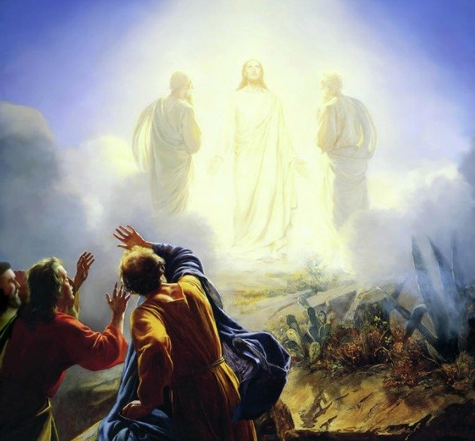
Hope (John 14:7)
If ye had known me, ye should have known my Father also: and from henceforth ye know him, and have seen him.

Slide 48
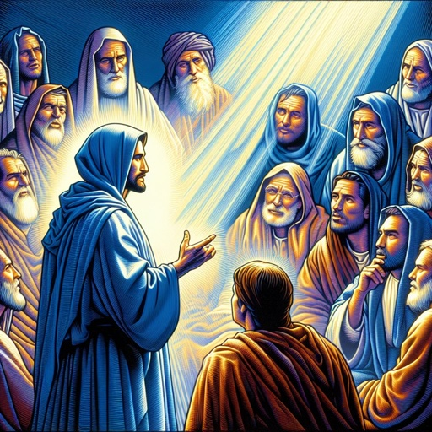
Hope (John 14:8)
Philip saith unto him, Lord, shew us the Father, and it sufficeth us.

Slide 49
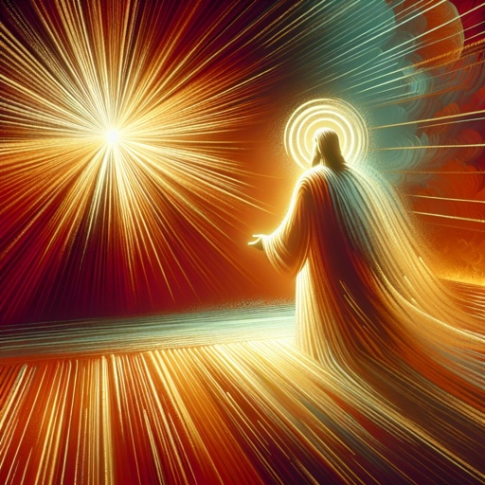
Hope (John 14:9)
Jesus saith unto him, Have I been so long time with you, and yet hast thou not known me, Philip? he that hath seen me hath seen the Father; and how sayest thou then, Shew us the Father?

Slide 50
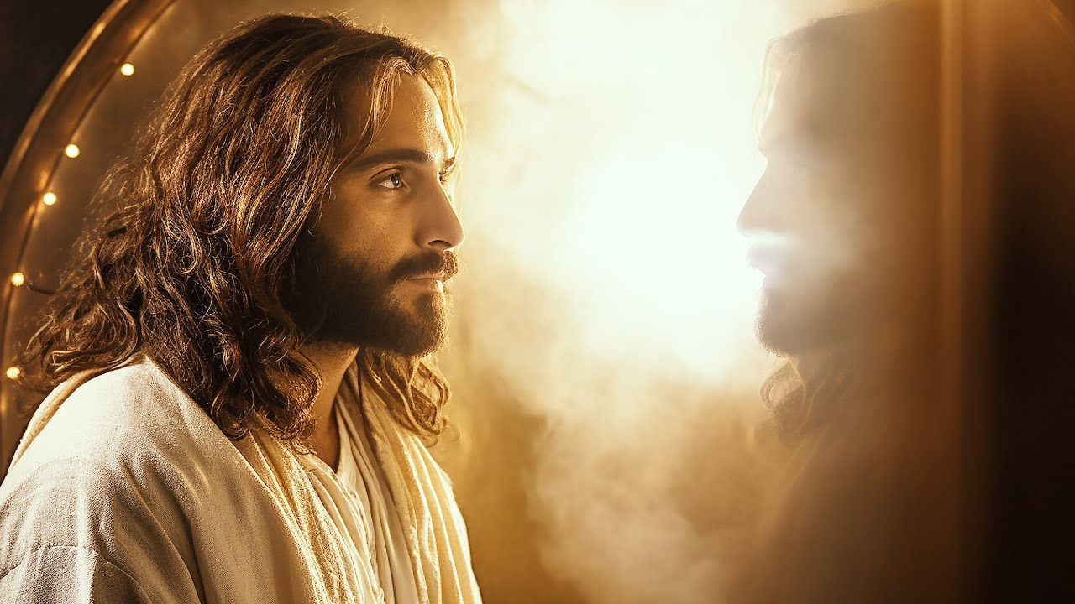
Hope (John 14:10)
Believest thou not that I am in the Father, and the Father in me? the words that I speak unto you I speak not of myself: but the Father that dwelleth in me, he doeth the works.

Slide 51
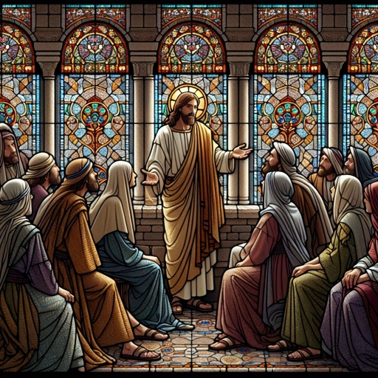
Hope (John 14:11)
Believe me that I am in the Father, and the Father in me: or else believe me for the very works' sake.

Slide 52

Hope (John 14:12)
Verily, verily, I say unto you, He that believeth on me, the works that I do shall he do also; and greater works than these shall he do; because I go unto my Father.

Slide 53
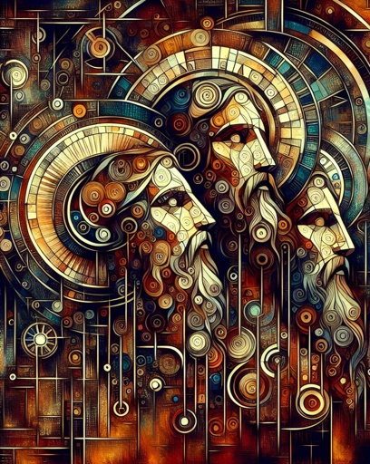
Faith
If the disciples believed this vital connection between the Father and the Son, their faith would not forsake them when they saw Christ's suffering and death to save a perishing world.
The Desire of Ages p. 664

Slide 54
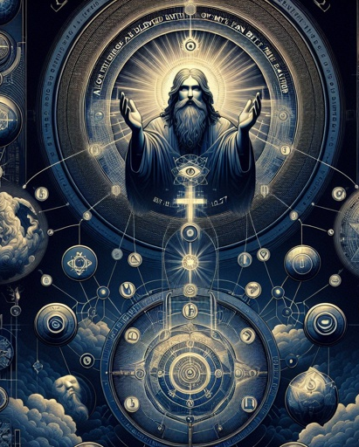
Faith
Christ was seeking to lead them from their low condition of faith to the experience they might receive if they truly realized what He was,—God in human flesh. He desired them to see that their faith must lead up to God, and be anchored there.
The Desire of Ages p. 664

Slide 55

Faith
After the Lord's ascension, the disciples realized the fulfillment of His promise. The scenes of the crucifixion, resurrection, and ascension of Christ were a living reality to them. They saw that the prophecies had been literally fulfilled.
The Desire of Ages p. 667

Slide 56

Faith
They searched the Scriptures, and accepted their teaching with a faith and assurance unknown before. They knew that the divine Teacher was all that He had claimed to be.
The Desire of Ages p. 667

Slide 57
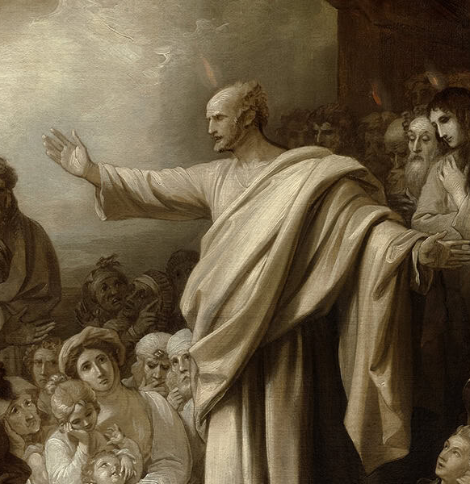
Faith
As they told their experience, and exalted the love of God, men's hearts were melted and subdued, and multitudes believed on Jesus.
The Desire of Ages p. 667

Slide 58

Faith
The Saviour's promise to His disciples is a promise to His church to the end of time. God did not design that His wonderful plan to redeem men should achieve only insignificant results.
The Desire of Ages p. 667

Slide 59

Faith
All who will go to work, trusting not in what they themselves can do, but in what God can do for and through them, will certainly realize the fulfillment of His promise. “Greater works than these shall ye do,” He declares; “because I go unto My Father.”
The Desire of Ages p. 667

Slide 60
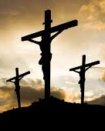
Faith
The Lord is disappointed when His people place a low estimate upon themselves. He desires His chosen heritage to value themselves according to the price He has placed upon them. God wanted them, else He would not have sent His Son on such an expensive errand to redeem them.
The Desire of Ages p. 668

Slide 61
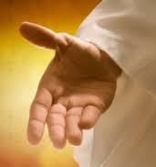
Faith
He has a use for them, and He is well pleased when they make the very highest demands upon Him, that they may glorify His name. They may expect large things if they have faith in His promises.
The Desire of Ages p. 668

Slide 62

Faith
But to pray in Christ's name means much. It means that we are to accept His character, manifest His spirit, and work His works. The Saviour's promise is given on condition.
The Desire of Ages p. 668

Slide 63

Faith
“If ye love Me,” He says, “keep My commandments.” He saves men, not in sin, but from sin; and those who love Him will show their love by obedience.
The Desire of Ages p. 668

Slide 64
THANK YOU!
…and have an AMAZING SABBATH!!

